Slide 1

Samuel Parkin’s Portfolio Report

Slide 2
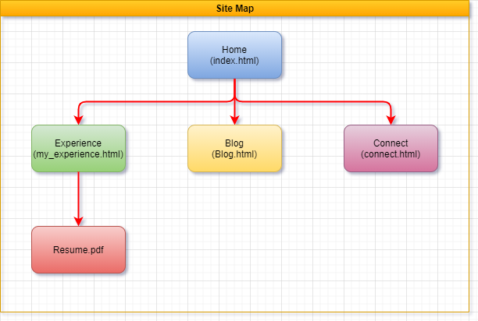
Site Map

Slide 3
Design process and decisions
The page was to have a minimalist feel to it.
Wanted to have the content to be displayed on card/tile.
Wanted to have a separate menu for mobile used.
Needed to have symmetry across all pages and devices.
To only use HTML and CSS. Avoid having to use JavaScript.

Slide 4
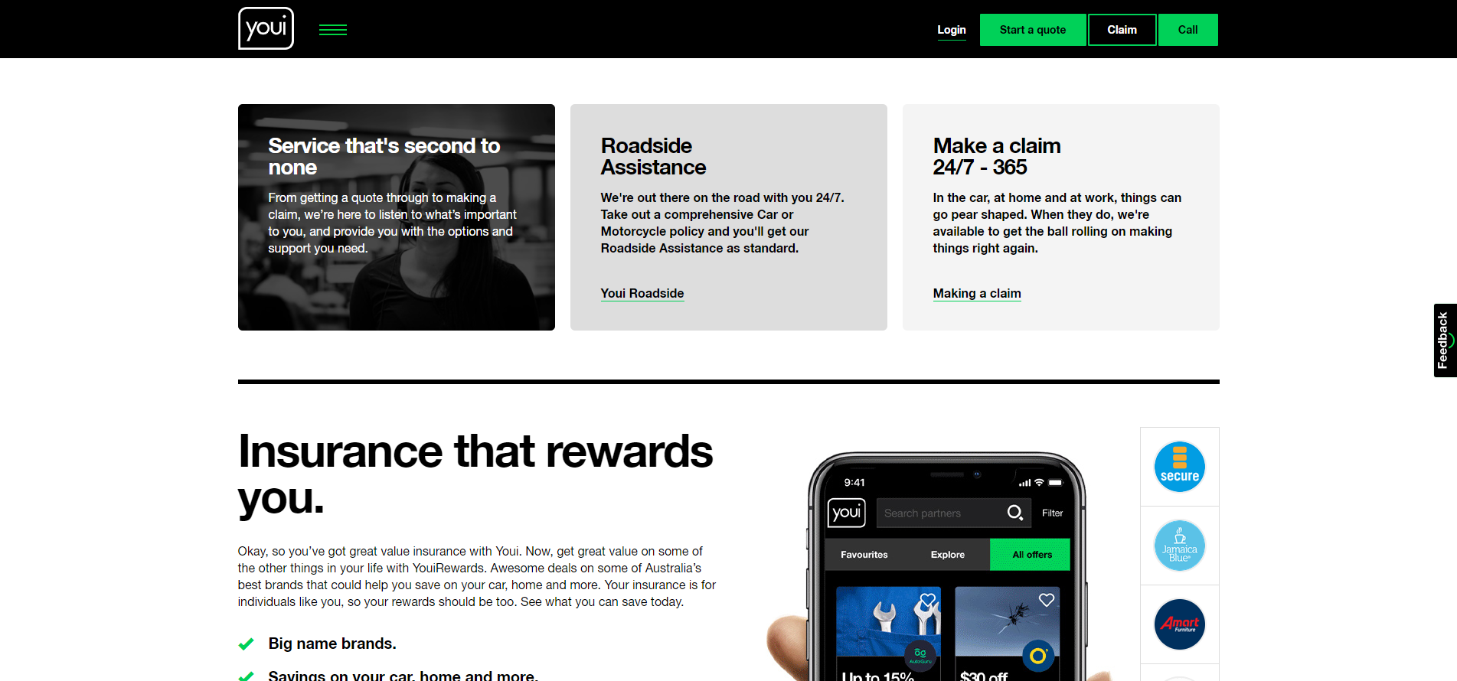
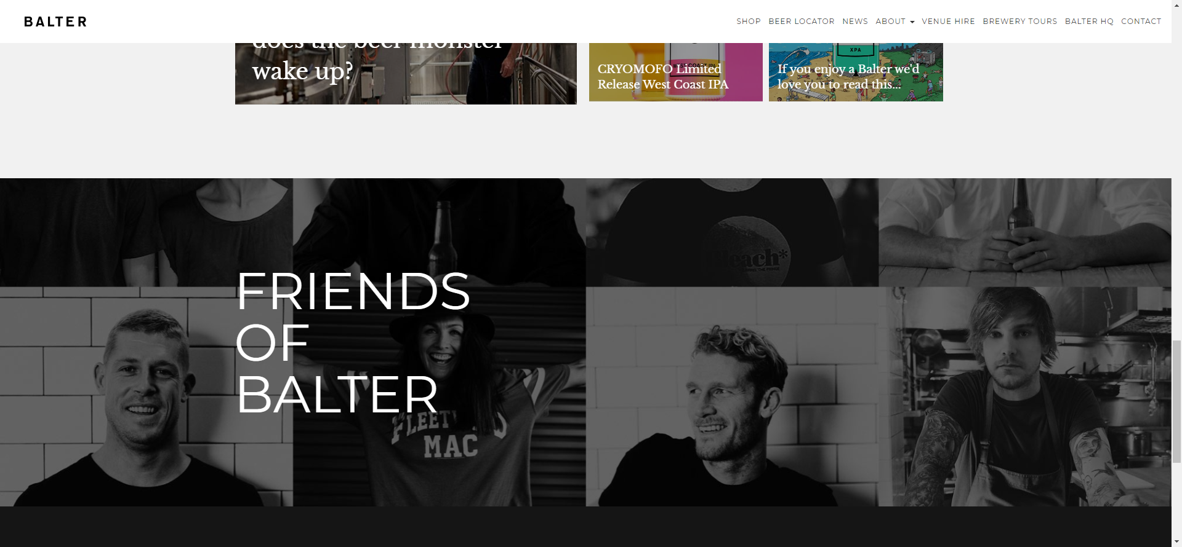
Inspirations
Inspiration was taken from Youi insurance and Balter Brewery websites.
The minimalist effect using a black and white contrast.
Bright color used for menu hover and selection.
A Split top menu having selections on both sides of the page.
Static background image.

Slide 5
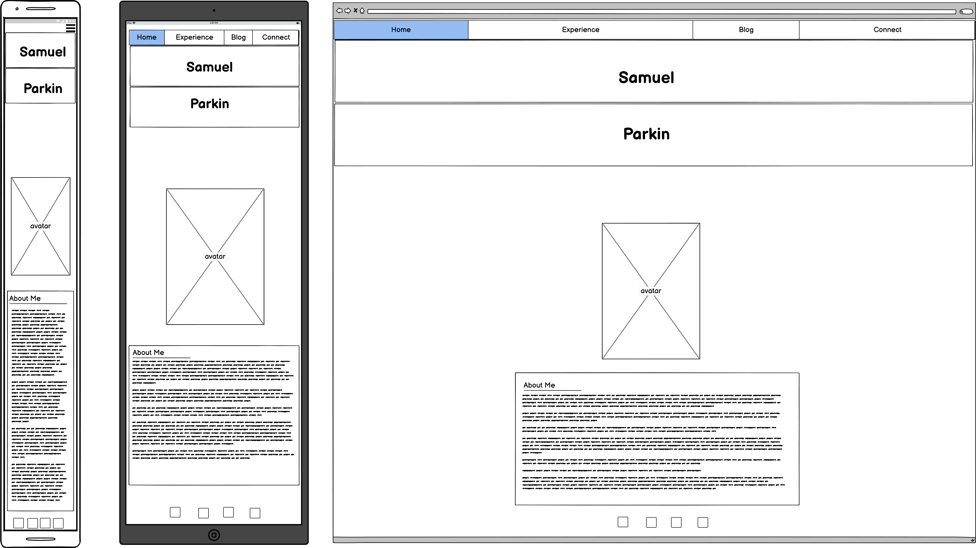
Wireframe of Home Page
Notes:
Your decision making process relating to the overall aesthetic of your website
What decisions did you make?
Why did you make those decisions?

Slide 6
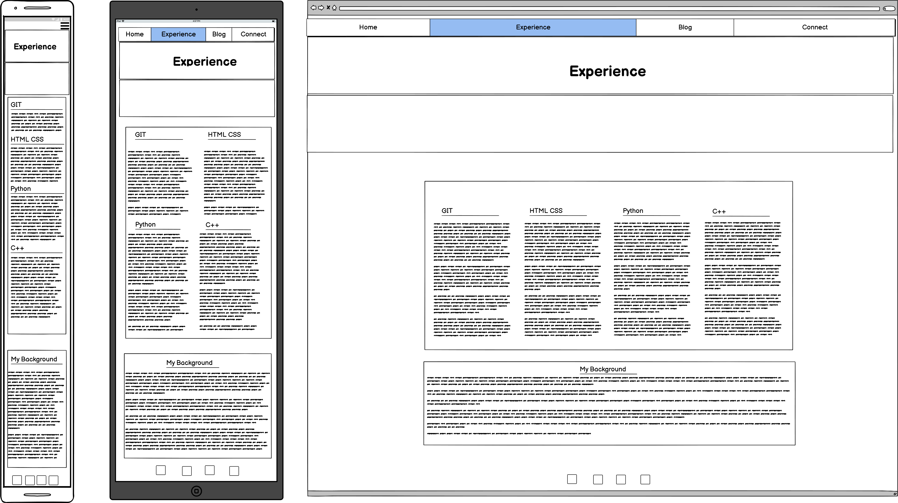
Wireframe of Experience Page
Notes:
Your decision making process relating to the overall aesthetic of your website
What decisions did you make?
Wanted to put relevant IT experience on the top.
Why did you make those decisions?
That’s going to be what an employer is looking for.

Slide 7
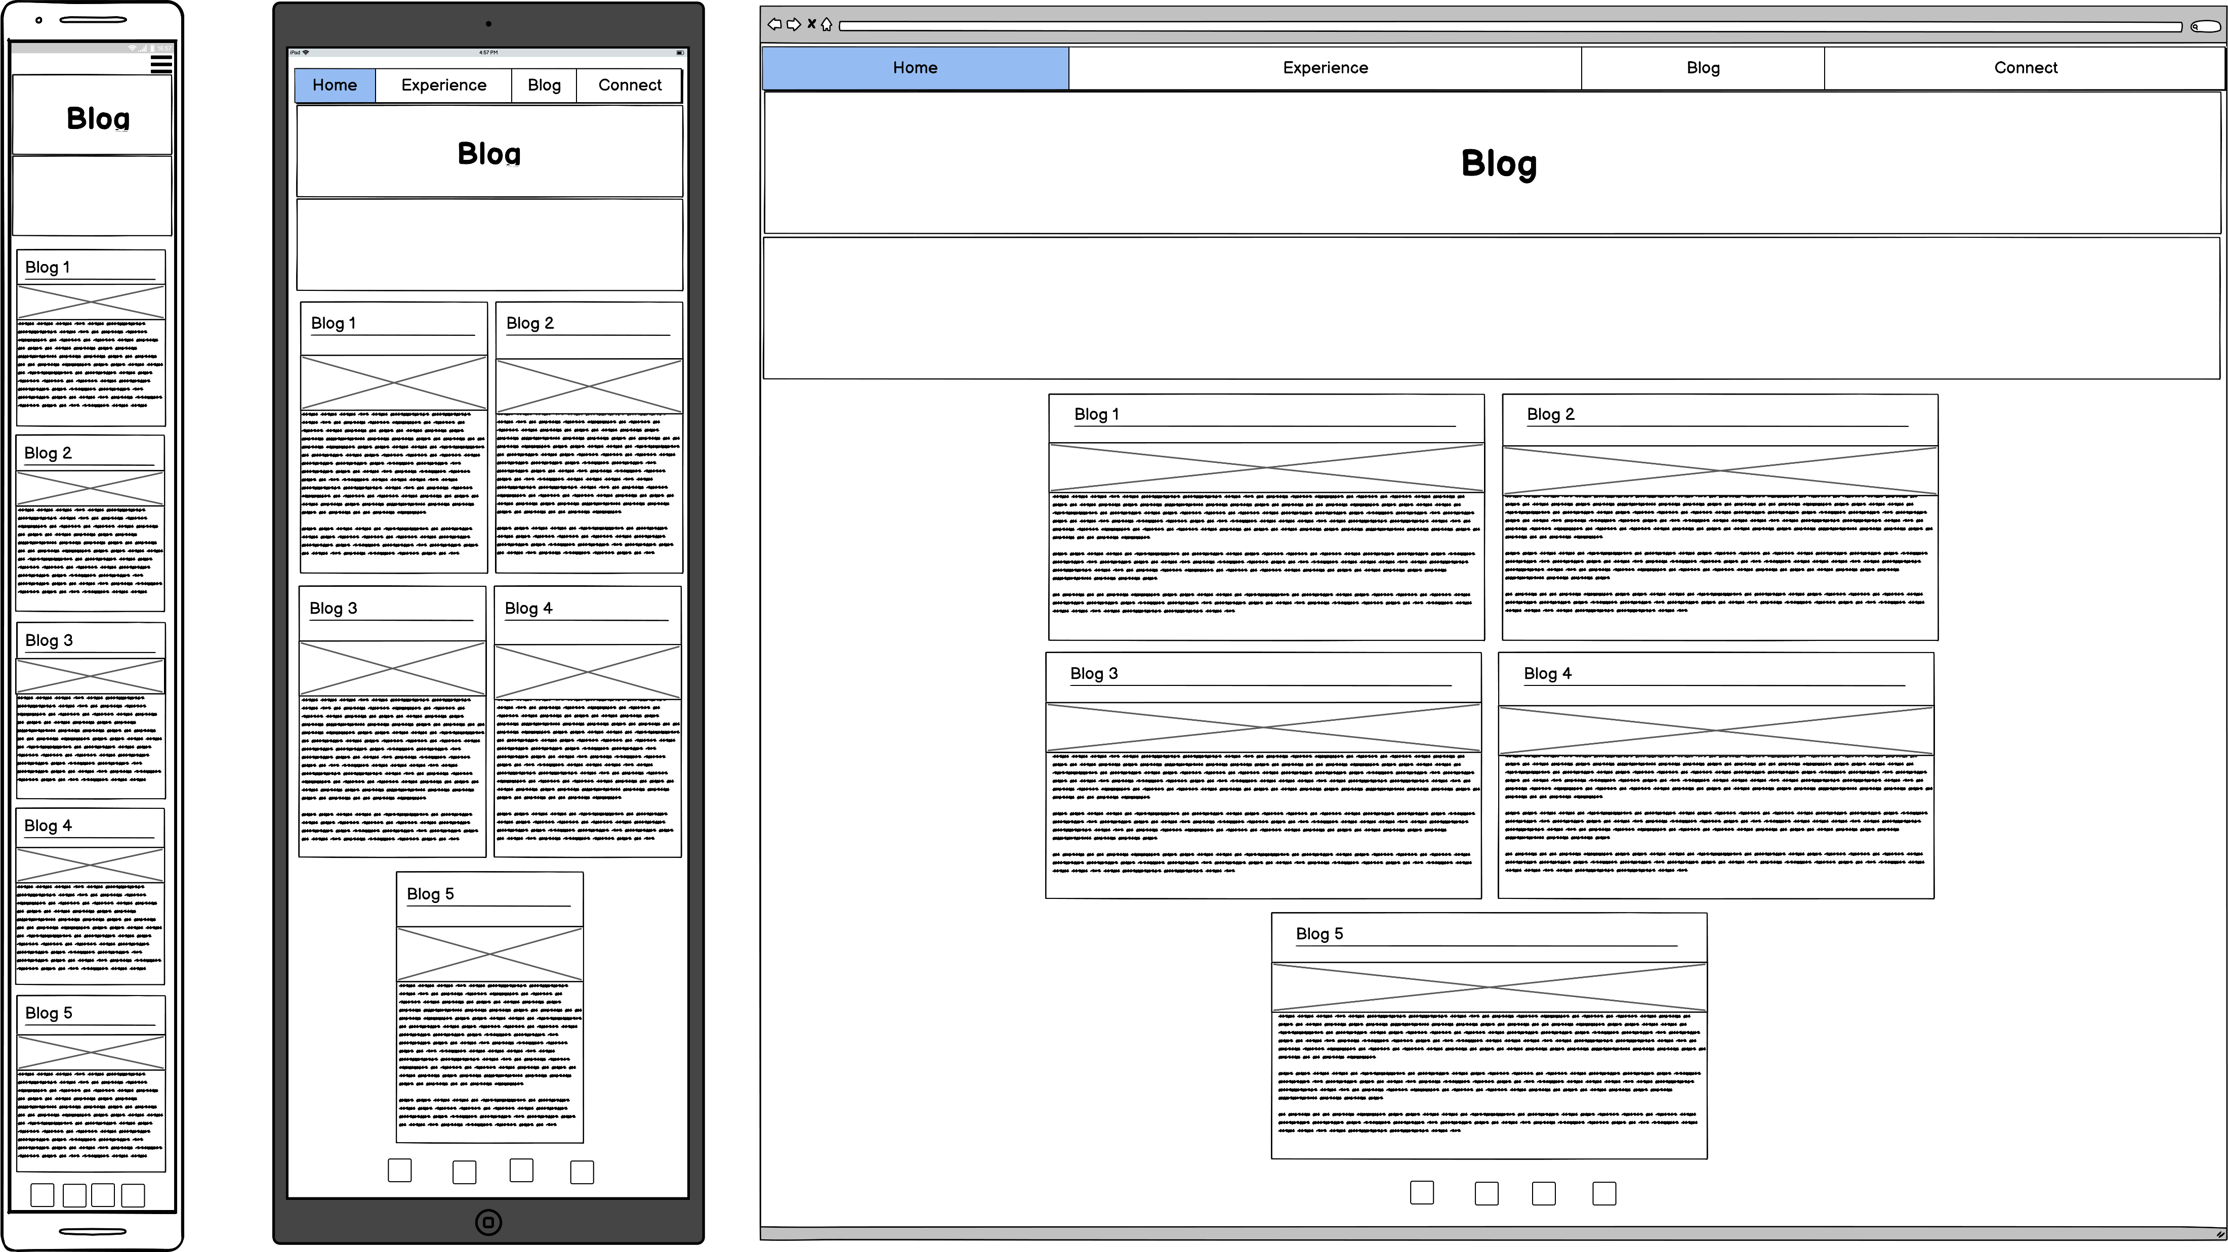
Wireframe of Blog Page
Notes:
Your decision-making process relating to the overall aesthetic of your website:
What decisions did you make? Each blog was going to be on its own tile
Why did you make those decisions? Allows the reader to focus on one blog at a time.

Slide 8
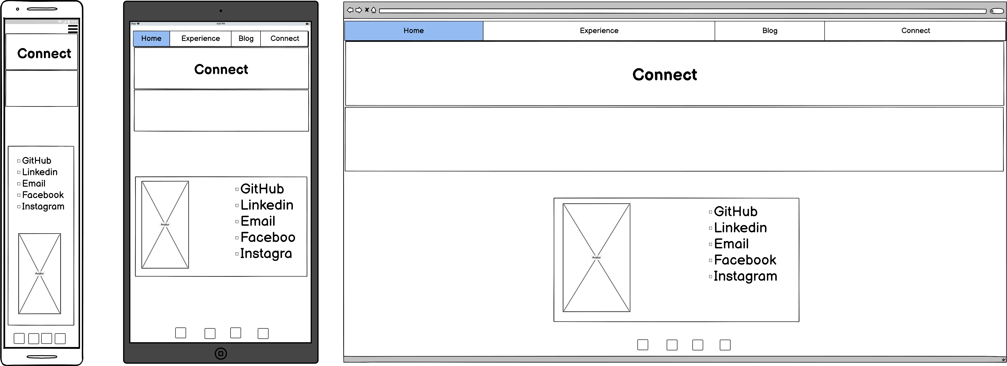
Wireframe of Connect Page
Notes:
Your decision making process relating to the overall aesthetic of your website
What decisions did you make?
I was thinking of have a contact form box.
Wanted the contact card to have a business card appearance
Why did you make those decisions?
Decided not to have a contact form box because that might involve some type of JavaScript.

Slide 9
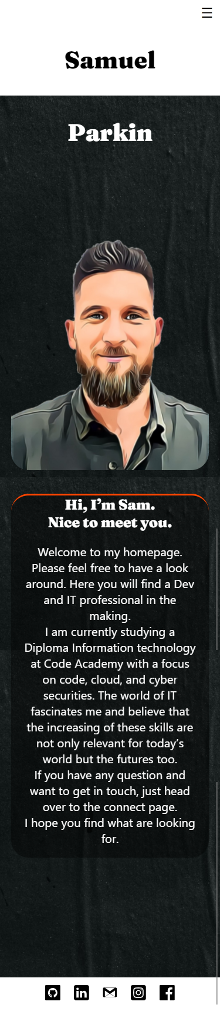
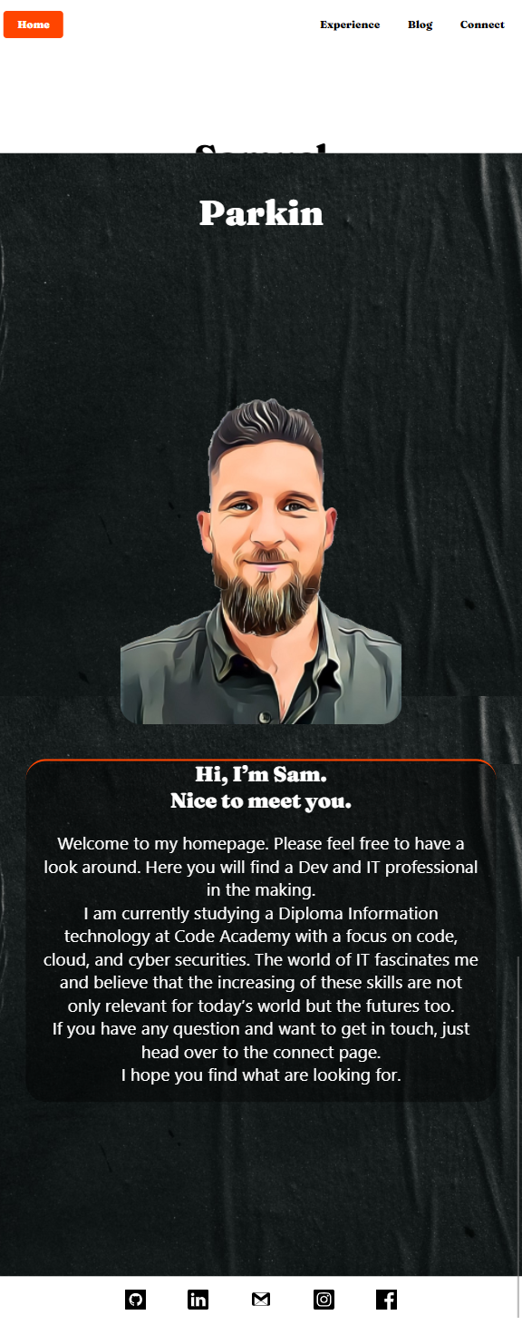
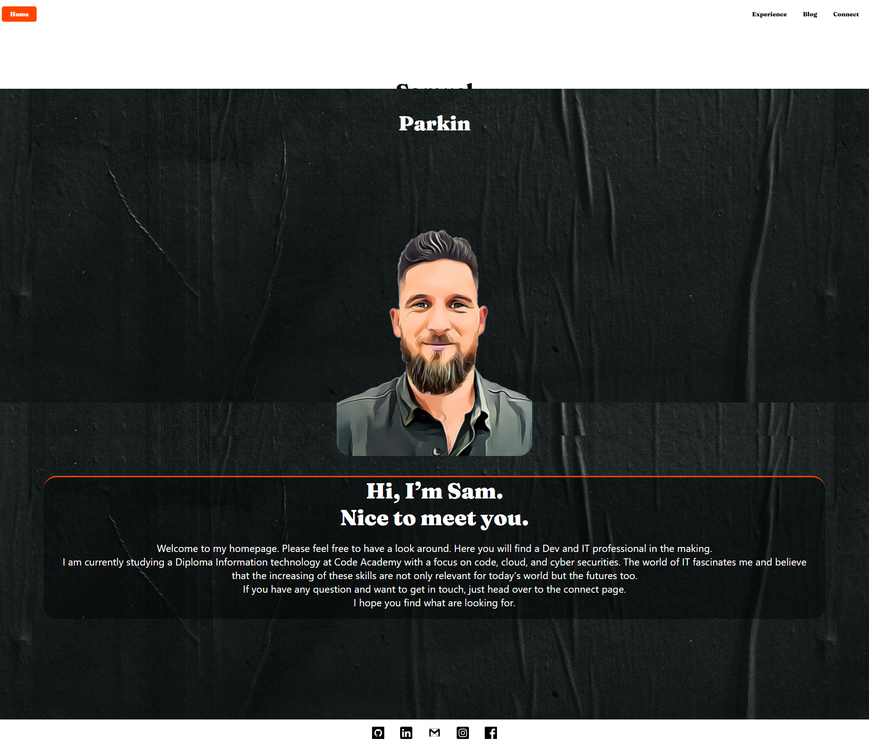
Portfolio Home Page
Notes:
Challenges- photo of avatar.
ethical issues – does the employer need to know what my face looks like?
favourite parts-

Slide 10
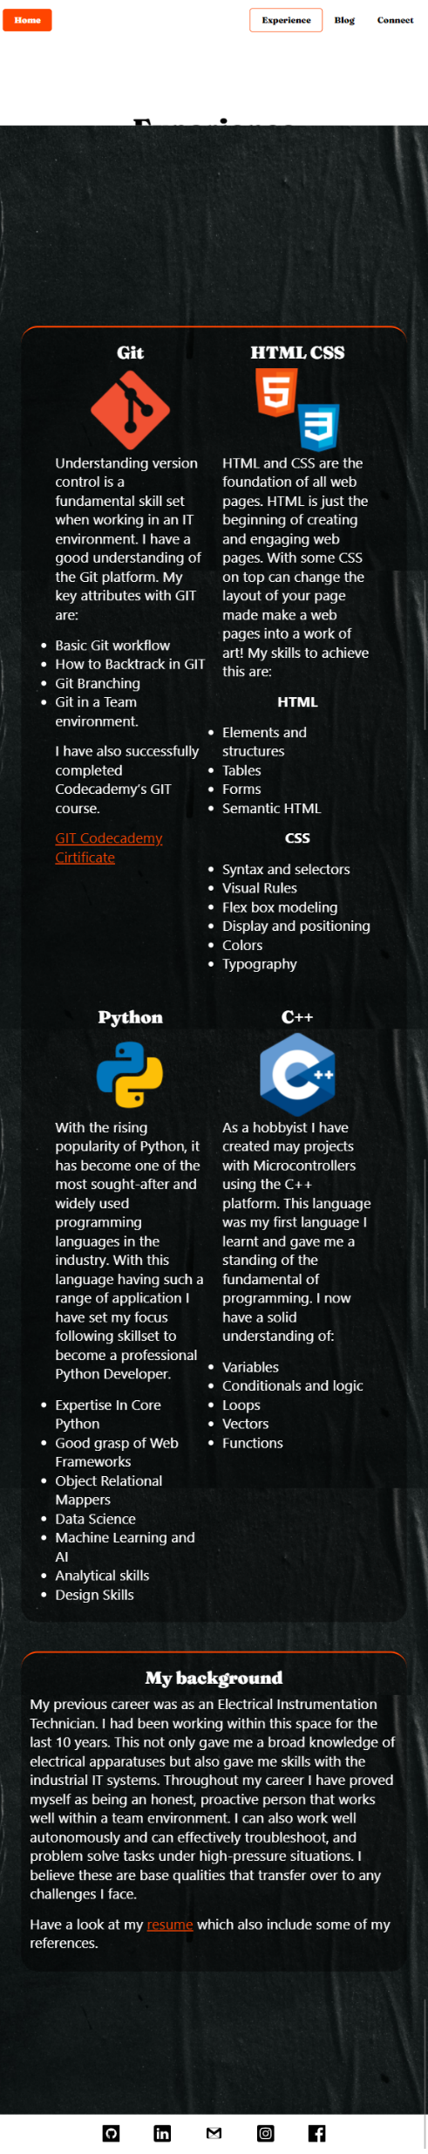
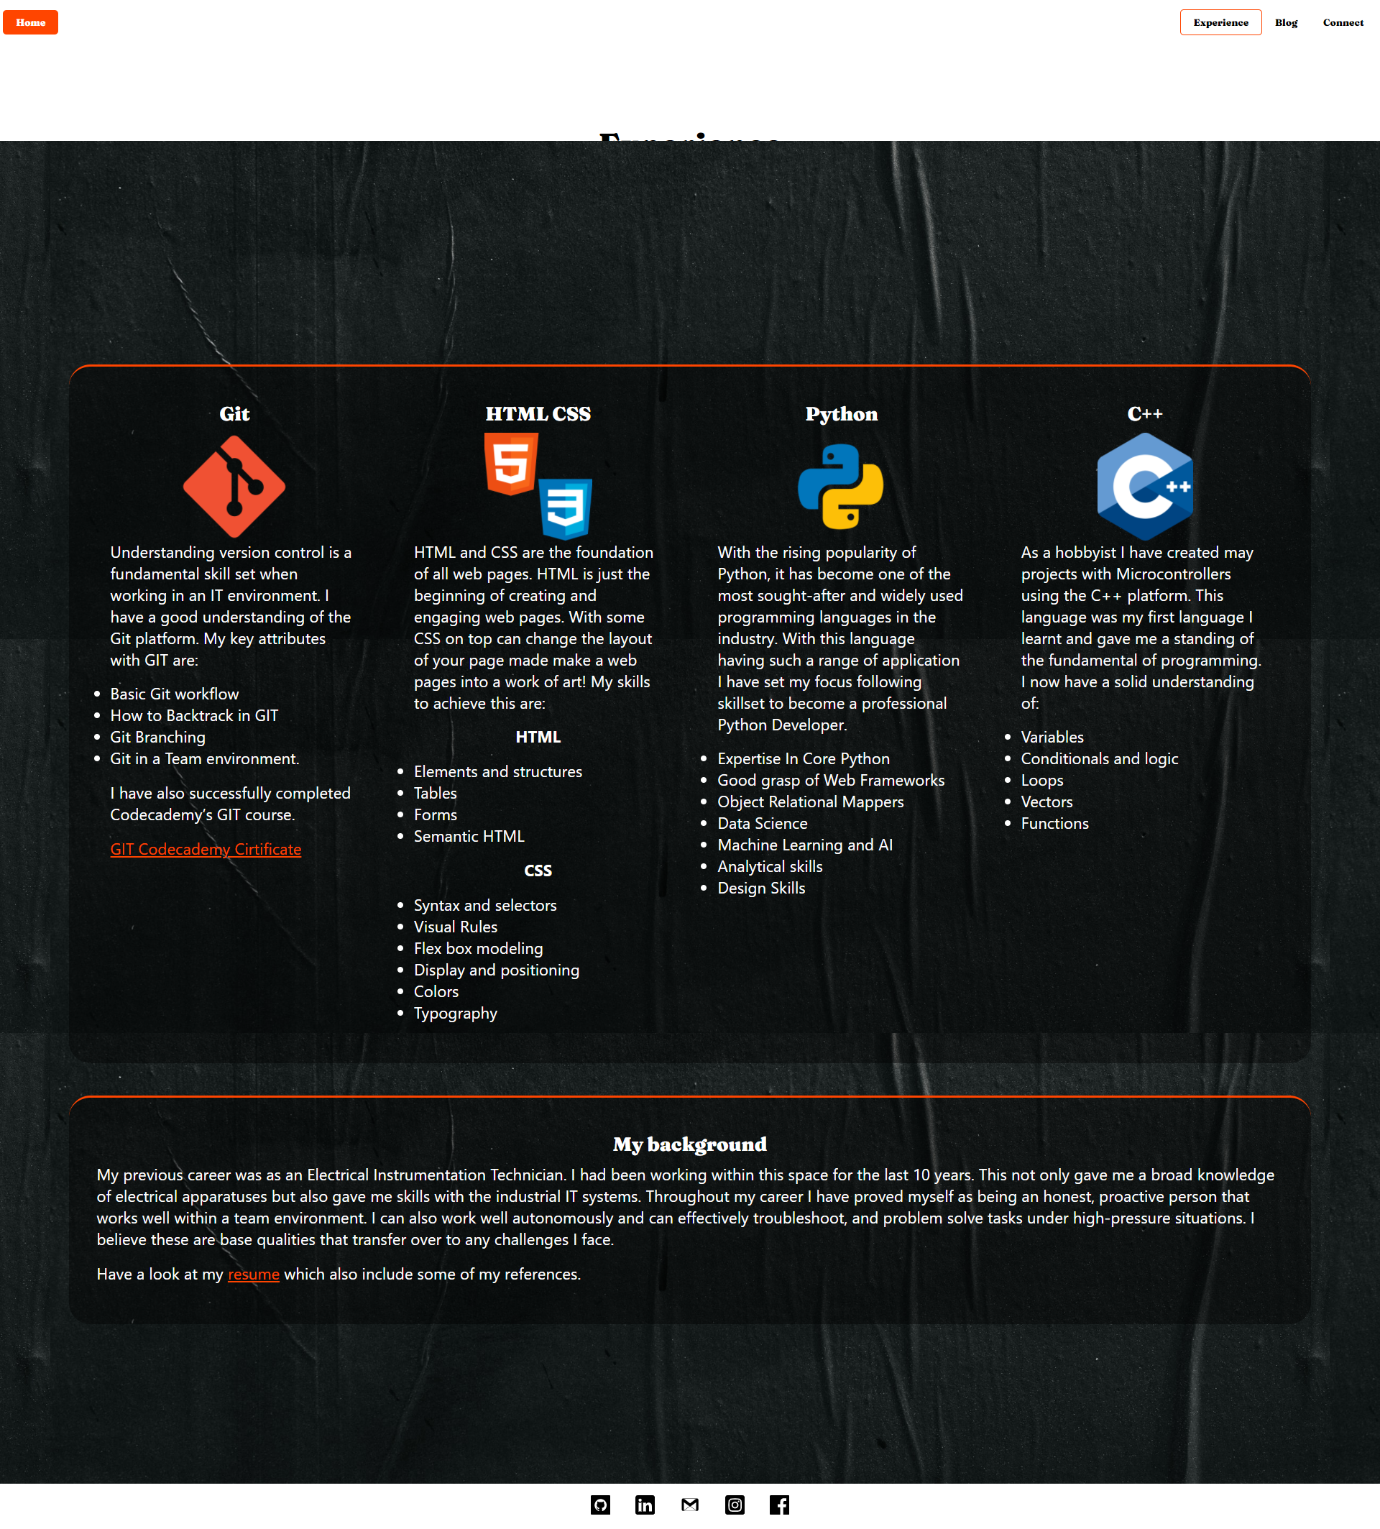
Portfolio Experience Page
Notes:
Challenges- getting the flex box to adjust correctly when changing screen size.
ethical issues – they’re not my logos.
favorite parts- I like how the logo appear on the page.

Slide 11
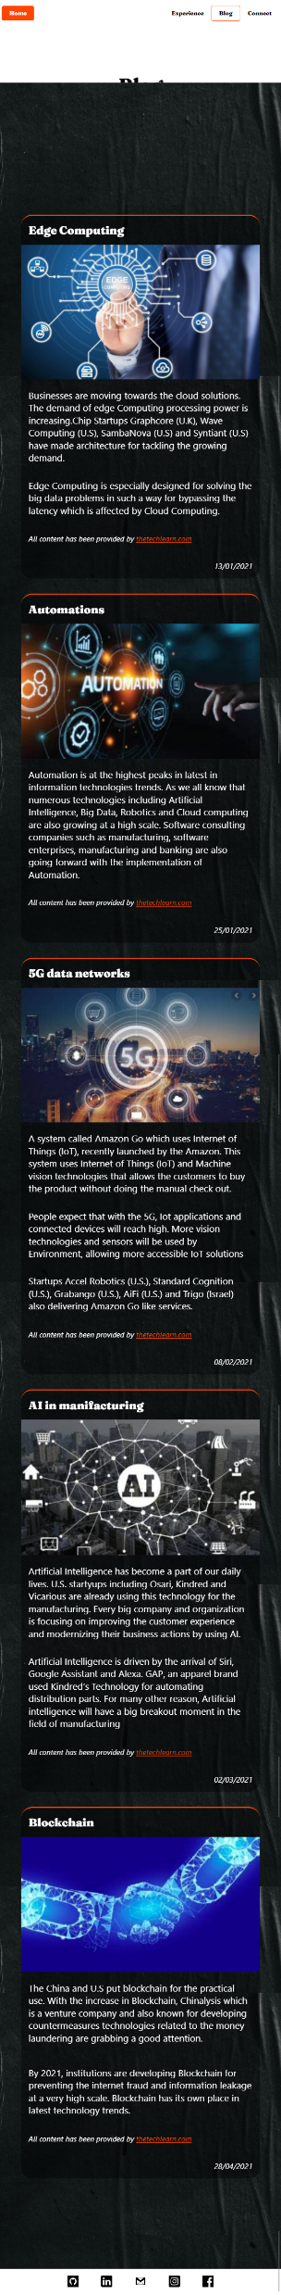
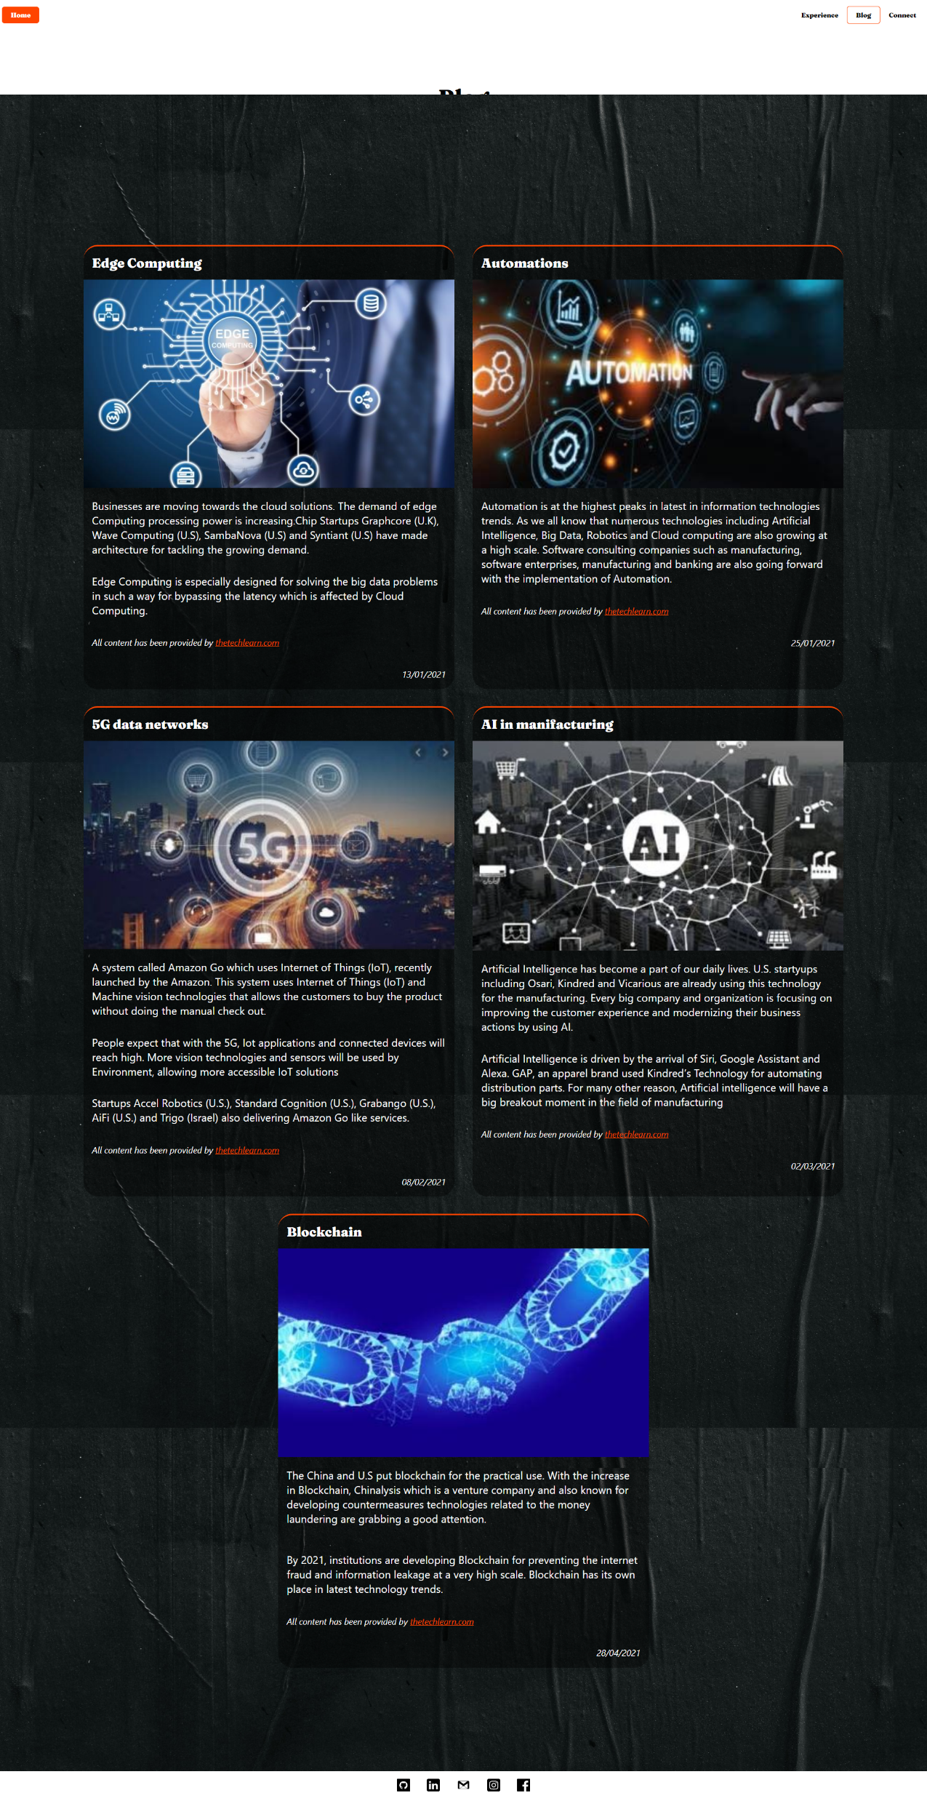
Portfolio Blog Page
Notes:
Challenges- getting the flex box to adjust correctly when changing screen size.
ethical issues – they’re not my blogs.
favorite parts- I like how the tiles stack up when changing screen size.

Slide 12
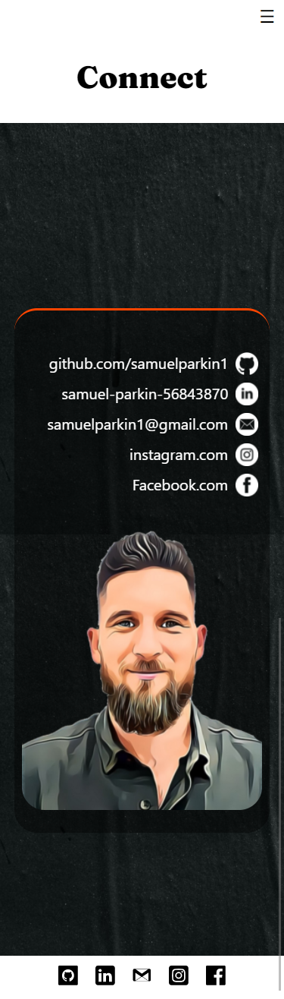
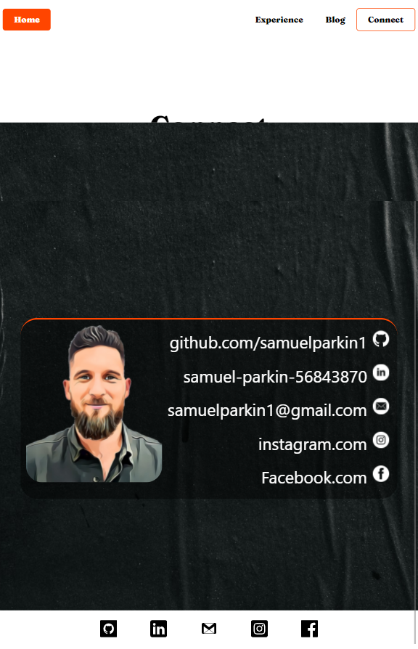
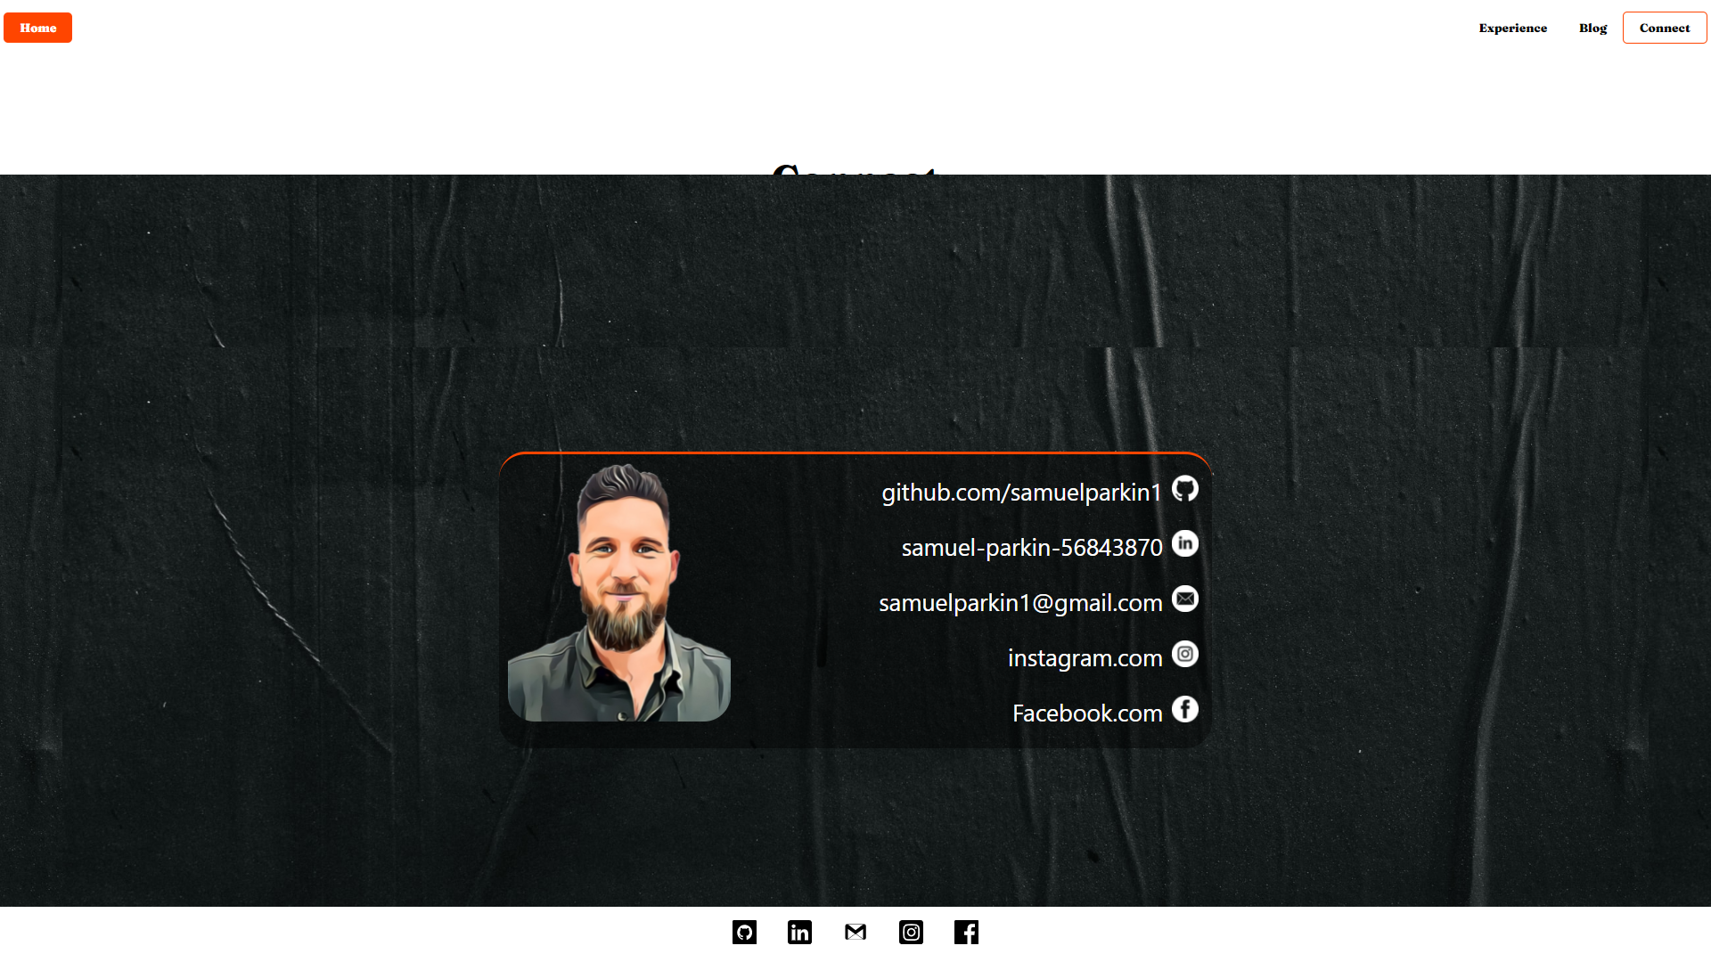
Portfolio Connect Page
Notes:
Challenges- using flex box to making the text to start on the right side of the card.
ethical issues – putting my personal email in might resolve in unwanted emails.
favorite parts – during the design phase I wanted it to appear like a business card which I think it does

Slide 13
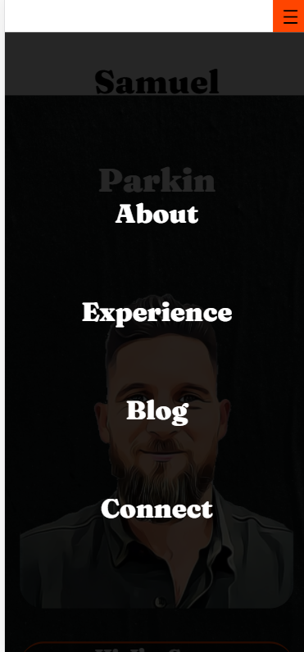
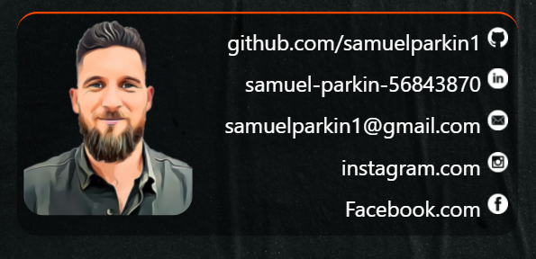

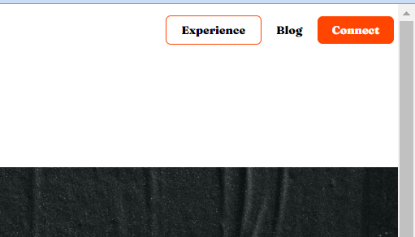
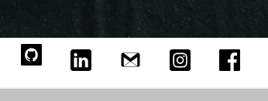
Components and features
Mobile Fullscreen menu
Header transition.
Hover and selected menu bar.
The transparent and orange border tiles used through out.
Pop up footer icons
Notes:
How components and styling will engage the audience:
Mobile Fullscreen menu
Header transition.
Hover and selected menu bar.
The transparent and orange border tiles used through out.
Pop up footer

Slide 14
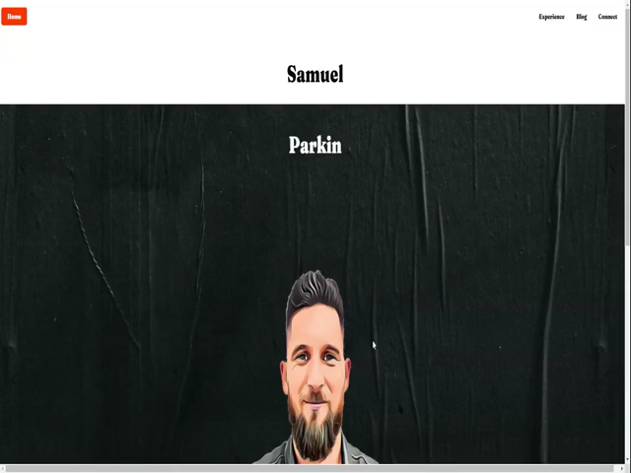
Video Walkthrough
Notes:
How components and styling will engage the audience

Slide 15
Challenges, ethical issues & favourite parts
Challenges:
Time management
Floating header
Design phase expectations vs build knowledge
Ethical issues:
Blog content and images are not my own.
Favourite parts:
Small wins after troubleshooting issues.
Having my first functioning website.

